Slide 1
Travel Package Purchase Prediction

Slide 2
Problem Statement:
Tourism is one of the most rapidly growing global industries and tourism forecasting is
becoming an increasingly important activity in planning and managing the industry.
Because of high fluctuations of tourism demand, accurate predictions of purchase of
travel packages are of high importance for tourism organizations.
The goal is to predict whether the customer will purchase the travel or not.
Approach: The classical machine learning tasks like Data Exploration, Data Cleaning,
Feature Engineering, Model Building and Model Testing. Try out different machine
learning algorithms that’s best fit for the above case.
We need to analyze the customers' data and information to provide recommendations to the Policy Maker and Marketing Team and also build a model to predict the potential customer who is going to purchase the newly introduced travel package.

Slide 3
Data Description
- Customer details:
CustomerID: Unique customer ID
ProdTaken: Whether the customer has purchased a package or not (0: No, 1: Yes)
Age: Age of customer
TypeofContact: How customer was contacted (Company Invited or Self Inquiry)
CityTier: City tier depends on the development of a city, population, facilities, and living standards. The categories are ordered i.e. Tier 1 > Tier 2 > Tier 3
Occupation: Occupation of customer
Gender: Gender of customer
NumberOfPersonVisiting: Total number of persons planning to take the trip with the customer
PreferredPropertyStar: Preferred hotel property rating by customer
MaritalStatus: Marital status of customer
NumberOfTrips: Average number of trips in a year by customer
Passport: The customer has a passport or not (0: No, 1: Yes)
OwnCar: Whether the customers own a car or not (0: No, 1: Yes)
NumberOfChildrenVisiting: Total number of children with age less than 5 planning to take the trip with the customer
Designation: Designation of the customer in the current organization
MonthlyIncome: Gross monthly income of the customer
- Customer interaction data:
PitchSatisfactionScore: Sales pitch satisfaction score
ProductPitched: Product pitched by the salesperson
NumberOfFollowups: Total number of follow-ups has been done by the salesperson after the sales pitch
DurationOfPitch: Duration of the pitch by a salesperson to the customer

Slide 4
Observation Trend for most of the customers who purchased King package:
Age Group: 42 - 56
Contacted by: Self
Gender: Female
City Tier: 1
Occupation: Small Business
Number of Persons Visiting: 2 - 3
Marital Status: Single
Designation: VP
Monthly Income Mean: ~35K

Slide 5
ARCHITECTURE
Data collection and Insertion
Understanding Of Data
Data pre-processing
Data Visualization
Performance Tabulation
Model Building
Outlier Treatment
Outlier Detection
Handling of imbalanced data
Standardizing of Data
Rebuilding of Model
Performance Tabulation
Model Saving
Selecting Best Model
Performance Tabulation
Tuning of model
Cloud deployment
Data insertion for prediction
Prediction

Slide 6
DATA COLLECTION AND INSERTION
Data collection and insertion in machine learning (ML) are critical steps in building and training machine learning models. These steps involve gathering, preparing, and integrating data for use in ML applications.
Data collected from
https://www.kaggle.com/datasets/sanamps/tourpackageprediction
Data read from .csv file
C:\Users\Admin\Desktop\ML_Project\travel\Travel-Package-Purchase-Project-using-CICD-Pipeline-main\data\tour_package.csv

Slide 7
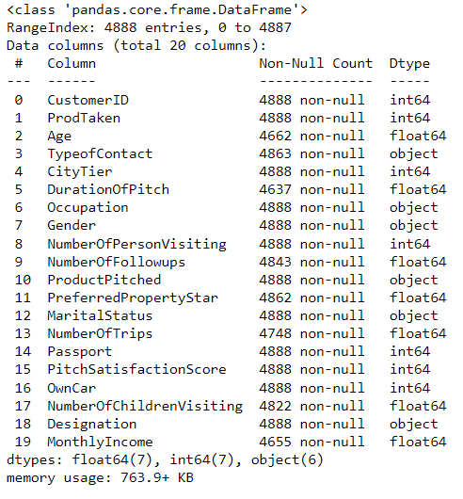
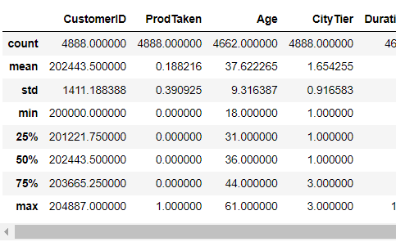
UNDERSTANDING OF DATA
Checking for size of data
Checking for statistical description of data
Checking for data types of columns
Value counts for categorical columns

Slide 8
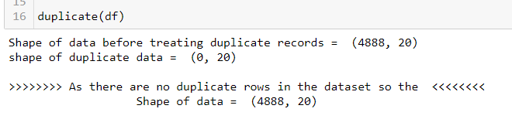
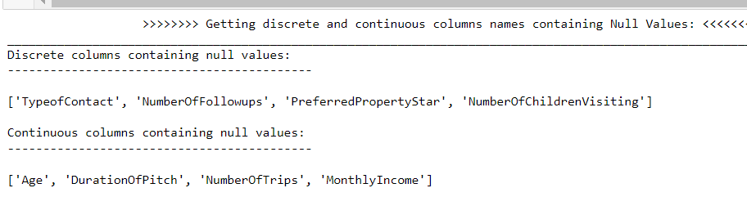
DATA - PREPROCESSING
Data preprocessing in machine learning is the process of cleaning, transforming, and organizing raw data to make it suitable for model training, improving data quality, and model performance.
Steps in data pre-processing
Handling of duplicate records and columns
Handling of Null Values
Handling of Categorical Data
Handling of Numerical Data
Handling of Outliers
Data Transformation

Slide 9

DATA VISUALIZATION
Data visualization is the graphical representation of data using charts, graphs, and other visual elements to convey insights and patterns within the data.
Visualizations of each categorical features
Visualizations of each categorical features with Target variable
Visualizations of each numerical continuous features
Visualizations of each numerical discrete features

Slide 10
OUTLIER DETECTION AND TREATMENT
Outlier detection is the process of identifying data points that deviate significantly from the majority of the dataset.
Outlier treatment involves deciding whether to remove, transform, or handle these outliers to improve the quality and robustness of data analysis and modeling.
Methods To Remove Outliers
Removal:
Delete or exclude outlier data points from the dataset.
Transformation:
Apply mathematical transformations (e.g., log, square root) to mitigate the impact of outliers.
Click here
Methods To Detect Outliers
Z-Score or Standard Score:
Identifies data points that are significantly different from the mean.
IQR (Interquartile Range):
Detects outliers based on the range between the first and third quartiles.
Visual Inspection:
Using box plots, scatter plots, or histograms to visually identify unusual data points.
Click here

Slide 11
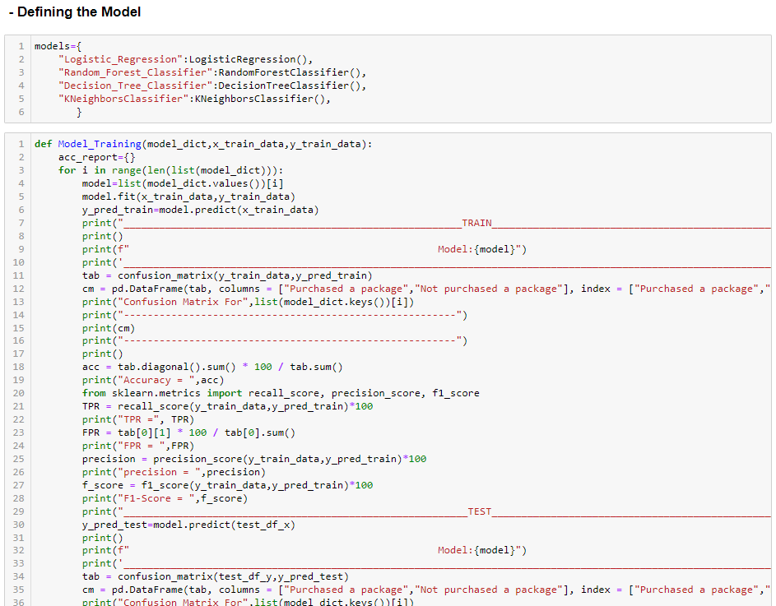
MODEL BUILDING AND PERFORMANCE TABULATION
Here we have build model on 4 different Algorithms
Logistic Regression Algorithm
Decision Tree Algorithm
Random Forest Algorithm
K-Nearest Neighbors Algorithm
Models
Performance Metrics

Slide 12
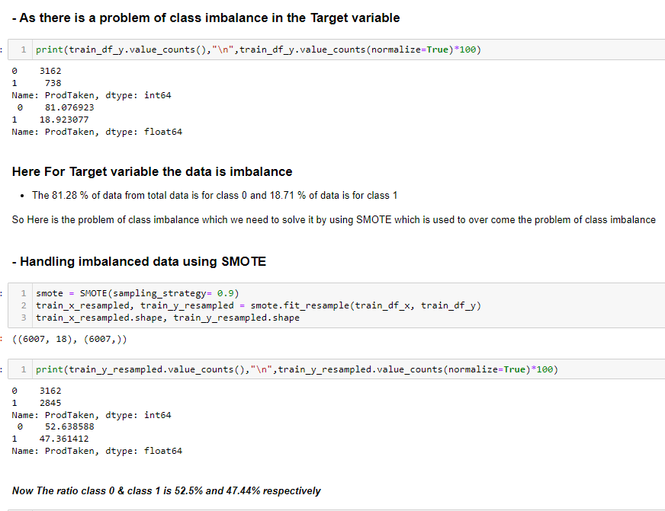
HANDLING OF IMBALANCED DATA & STANDARDIZATION OF DATA

Slide 13
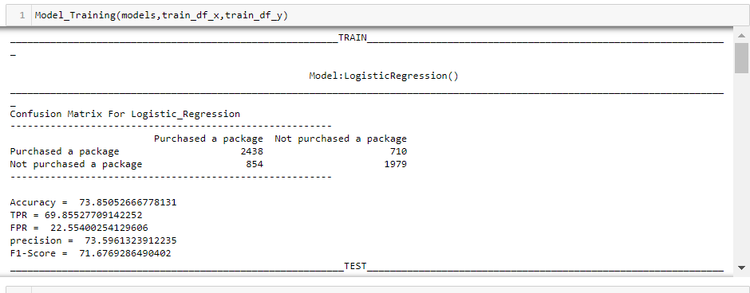
REBUILDING OF MODEL & PERFORMANCE TABULATION
After handling of imbalanced data and after transforming the data we again rebuild the model and check for its performance but there is not that much difference in the performance of models
Models
Performance Metrics

Slide 14
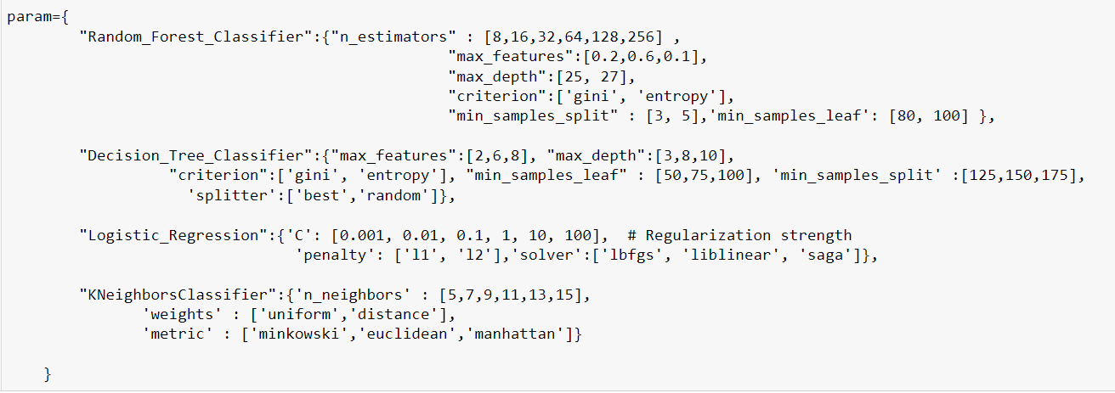
TUNING OF MODEL & PERFORMANCE TABULATION
As there is no effect of handling the imbalance data and the data transformation in order to get better performance here we try to tuned the model by hyper parameter tuning.
Models
Performance Metrics

Slide 15
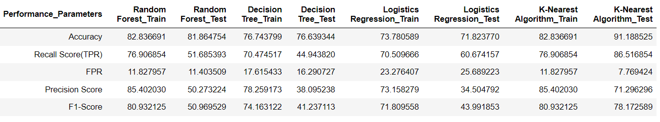
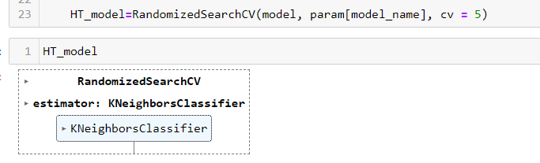
SELECTING BEST MODEL & MODEL SAVING
In terms of accuracy and precision the K-Nearest Neighbor model works better and gives good training and testing accuracy .
So we selected the best model as a K-Nearest Neighbor and we also checked for the RandomizedsearchCV which automatically selects the best model it also select the best model as KNN

Slide 16
Cloud Deployment

Slide 17
Data Insertion for rediction

Slide 18
Prediction

Slide 19
Introduction
1. Background of travel package purchase prediction
2. Importance of travel package purchase prediction for businesses
3. Challenges in travel package purchase prediction
Data collection and preprocessing
1. Sources of data for travel package purchase prediction
2. Data preprocessing techniques
3. Feature selection and engineering
Modeling and evaluation
1. Selection of appropriate machine learning algorithms
2. Training and testing the prediction model
3. Evaluation metrics for measuring the model's performance
Results and discussion
1. Analysis of the prediction model's accuracy and effectiveness
2. Interpretation of the predictive features
3. Potential implications and applications of the findings
Conclusion
1. Summary of the presentation
2. Future directions in travel package purchase prediction research
3. Closing remarks

